Slide 1

No Is a Leadership Act: Prioritization and Strategic Decision-Making
Mastering focus through effective choices and clear boundaries
Notes:
AI-generated content may be incorrect. ---

Slide 2
Introduction and Session Objectives
Notes:
Why Saying No Is Leadership

Slide 3

Why Saying No Is Leadership
Strategic Priority Setting
Saying no helps leaders define priorities and maintain organizational focus on mission-critical objectives.
Avoiding Decision Fatigue
Clear boundaries reduce decision fatigue and prevent diluted impact from excessive multitasking.
Empowering Teams
Saying no empowers teams to focus on high-value activities that align with long-term goals.
Modeling Disciplined Culture
Leaders saying no model disciplined decision-making, fostering a strategic and focused organizational culture.
Notes:
Saying “no” is often perceived as resistance or negativity, but in leadership, it is a strategic act that defines priorities and preserves organizational focus. Leaders face constant demands for resources, time, and attention, and without clear boundaries, teams risk falling into decision fatigue and diluted impact. By confidently declining initiatives that do not align with core objectives, leaders create space for what truly matters. This approach fosters clarity, empowers teams to concentrate on high-value activities, and signals commitment to long-term goals rather than short-term appeasement. For example, companies like Apple and Amazon have thrived by focusing on fewer, high-impact projects rather than spreading resources thin across multiple ventures. Furthermore, research on cognitive load shows that excessive multitasking reduces productivity and decision quality, reinforcing the need for prioritization. Saying no also strengthens organizational culture by modeling disciplined decision-making and encouraging team members to evaluate requests through a strategic lens. Ultimately, “no” is not about shutting doors—it is about opening the right ones and ensuring that every yes is intentional, impactful, and aligned with mission-critical objectives.

Slide 4
Core Concepts of Strategic Prioritization
Notes:
The Cost of Saying Yes to Everything, Framework for Deciding Yes or No

Slide 5

The Cost of Saying Yes to Everything
Resource Strain and Burnout
Indiscriminate yes commitments cause resource depletion and employee burnout, impacting organizational performance.
Decision Fatigue Effects
Leaders face decision fatigue from juggling many demands, resulting in reactive and ineffective choices.
Importance of Prioritization
Focused prioritization boosts revenue growth and employee engagement by aligning efforts on few key objectives.
Saying No as a Strategy
Saying no protects resources and empowers leadership by preventing overcommitment and maintaining strategic advantage.
Notes:
When leaders say yes indiscriminately, organizations experience resource strain, unclear priorities, and diminished performance. Every additional commitment consumes time, budget, and energy, often at the expense of existing strategic initiatives. Studies on organizational effectiveness reveal that companies attempting to pursue too many goals simultaneously underperform compared to those that concentrate on a few critical objectives. For instance, a Harvard Business Review study found that firms with fewer priorities achieved higher revenue growth and employee engagement. The hidden costs include burnout among staff, missed deadlines, and compromised quality. Moreover, decision fatigue sets in when leaders constantly juggle competing demands, leading to reactive rather than proactive choices. This environment fosters confusion, as teams struggle to discern what truly matters. By contrast, organizations that embrace disciplined prioritization—such as Google’s focus on core products—maintain agility and innovation. Leaders must recognize that every yes carries an opportunity cost, and without deliberate evaluation, these costs accumulate silently, eroding strategic advantage. Therefore, understanding the implications of overcommitment is essential for framing “no” as a protective and empowering leadership tool.

Slide 6
Framework for Deciding Yes or No
Criterion | Questions to Ask | Decision Implication
Strategic Alignment | Does it support our mission and goals? | If no, decline
Impact vs. Effort | Is the benefit worth the resources? | Prioritize high-impact, low-effort
Resource Availability | Do we have capacity to deliver? | If not, defer or decline
Timing | Is now the right time? | Schedule or postpone if misaligned
Opportunity Cost | What will we sacrifice by saying yes? | Decline if trade-offs are too high
Notes:
A structured decision-making framework helps leaders evaluate requests objectively and communicate decisions confidently. The first criterion is strategic alignment: does the initiative advance the organization’s mission and long-term goals? Second, assess impact versus effort—high-impact, low-effort projects often warrant a yes, while low-impact, high-effort tasks should be declined. Third, consider resource availability: do we have the capacity to execute effectively without compromising existing priorities? Fourth, evaluate timing and dependencies; even valuable projects may need to wait if conditions are not optimal. Finally, examine opportunity cost: what will be delayed or sacrificed by saying yes? Tools like priority matrices and decision checklists operationalize these principles, enabling leaders to visualize trade-offs and justify decisions transparently. For example, a nonprofit might use a scoring system to rank initiatives based on mission alignment, financial return, and stakeholder value. This structured approach transforms “no” from a subjective judgment into a rational, leadership-driven choice, reinforcing trust and clarity across the organization.

Slide 7
Interactive Exercises for Application
Notes:
Priority Mapping Activity, Role-Play: Saying No with Leadership Language

Slide 8

Priority Mapping Activity
Simulating Decision-Making
Participants rank priorities and decline projects to mimic real-world strategic decisions and resource allocation.
Discussion and Reflection
Teams discuss trade-offs and challenges like stakeholder pressure to justify their prioritization choices.
Learning Through Debriefing
Debrief explores group ranking patterns highlighting leadership courage and strategic focus.
Frameworks for Transparency
Using priority matrices helps make decisions transparent, defensible, and aligned with organizational goals.
Notes:
In this exercise, participants receive a list of ten hypothetical initiatives and are asked to rank their top three priorities while identifying which projects they would decline. This activity simulates real-world decision-making and highlights the importance of strategic alignment and resource allocation. Participants work in small groups to discuss trade-offs, justify their choices, and reflect on the reasoning behind their decisions. Facilitators should encourage dialogue around common challenges, such as stakeholder pressure or fear of missing opportunities. Debriefing involves comparing group rankings and exploring patterns—did most teams prioritize initiatives with clear mission alignment or those promising quick wins? This discussion reinforces the concept that leadership requires courage to say no, even when ideas seem attractive. By practicing prioritization in a safe environment, participants build confidence in applying these principles to their own roles. The exercise also demonstrates how structured frameworks, such as priority matrices, can transform subjective decisions into transparent, defensible choices that strengthen organizational focus.

Slide 9
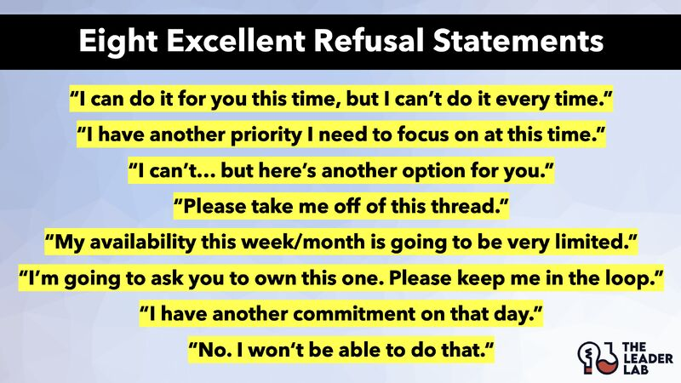
Role-Play: Saying No with Leadership Language
Practical Role-Playing
Participants practice declining requests using firm yet respectful language in paired role-plays.
Leadership Language
Use language that aligns refusals with organizational priorities, showing responsible leadership.
Feedback and Improvement
Partners provide feedback on tone, clarity, and effectiveness to strengthen communication skills.
Building Trust
Saying no respectfully can build trust and demonstrate leadership, overcoming common barriers.
Notes:
Role-playing equips participants with practical skills for declining requests without damaging relationships. In pairs, participants practice responding to scenarios such as a colleague requesting additional committee work or proposing a project outside the strategic plan. The objective is to use language that is firm yet respectful, emphasizing alignment with organizational priorities. For example, instead of a blunt refusal, participants might say, “I appreciate the idea, but it doesn’t align with our current strategic focus.” Facilitators should provide sample scripts and encourage participants to adapt them to their communication style. After each role-play, partners offer feedback on tone, clarity, and effectiveness. This exercise addresses common barriers to saying no, such as fear of conflict or disappointing others, and demonstrates that declining requests can strengthen trust when framed as a leadership decision. By practicing these conversations, participants leave with actionable strategies for real-world situations, reinforcing the session’s core message that saying no is not resistance—it is responsible leadership.

Slide 10
Reflection and Commitment
Notes:
Personal Action Plan

Slide 11

Personal Action Plan
Reflective Commitment Exercise
Participants identify one commitment to decline next semester to protect strategic priorities and apply learned principles.
Public Declaration for Accountability
Volunteers share their commitments publicly to foster accountability and support a culture of intentional decision-making.
Decision Checklist Tool
Participants use a checklist to systematically evaluate future requests and make focused decisions aligned with their mission.
Empowering Leadership Through 'No'
Leaders embrace saying 'no' to focus on the right tasks, enhancing clarity and organizational success.
Notes:
The session concludes with a reflective exercise where participants identify one commitment they will decline in the upcoming quarter to protect their strategic priorities. This step transforms theory into practice by prompting individuals to apply the principles discussed. Facilitators can use prompts such as, “What is one thing you will say no to this quarter?” and invite volunteers to share their commitments with the group. This public declaration fosters accountability and reinforces the cultural shift toward intentional decision-making. Additionally, participants can use a decision checklist provided in the handouts to evaluate future requests systematically. By ending with a forward-looking commitment, the session ensures that participants leave with a clear, actionable takeaway. This reflection emphasizes that leadership is not about doing everything—it is about doing the right things and having the courage to decline what does not serve the mission. Ultimately, this exercise empowers leaders to embrace “no” as a tool for focus, clarity, and organizational success.

Slide 12
Thank YOu
For further information or inquiry, please feel free to contact me at:
Kathryn Skulley, Ph.D.
Kathryn.Skulley@ccaurora.edu
720-255-5567

